Slide 1


Decision Tree Classification Algorithms
ID3
Brian Ewanyk, Adam Hill, Anton Medvedev

Slide 2
Introduction
Decision classification trees used for cases such as determination of loan eligibility
Known case data is used to develop a decision tree based on the trends of attribute options
New cases can then be evaluated based on past data employing the developed tree.
Iterative Dichotomizer 3 algorithm was employed and analyzed based on this scenario

Slide 3
Introduction
1966
1986
2016
Hunt’s Alg.
ID3
Iterative Dichotomizer 3(ID3) based on Hunt’s algorithm, developed in 1966
ID3 developed by Ross Quinlan in 1986

Slide 4
Introduction
ID3 develops a decision classification tree based on training data
Tree pivots can be determined by entropy or information gain
A GINI Index (information gain) is being used for pivot determination
Simulating the analysis used in determination of loan qualification

Slide 5
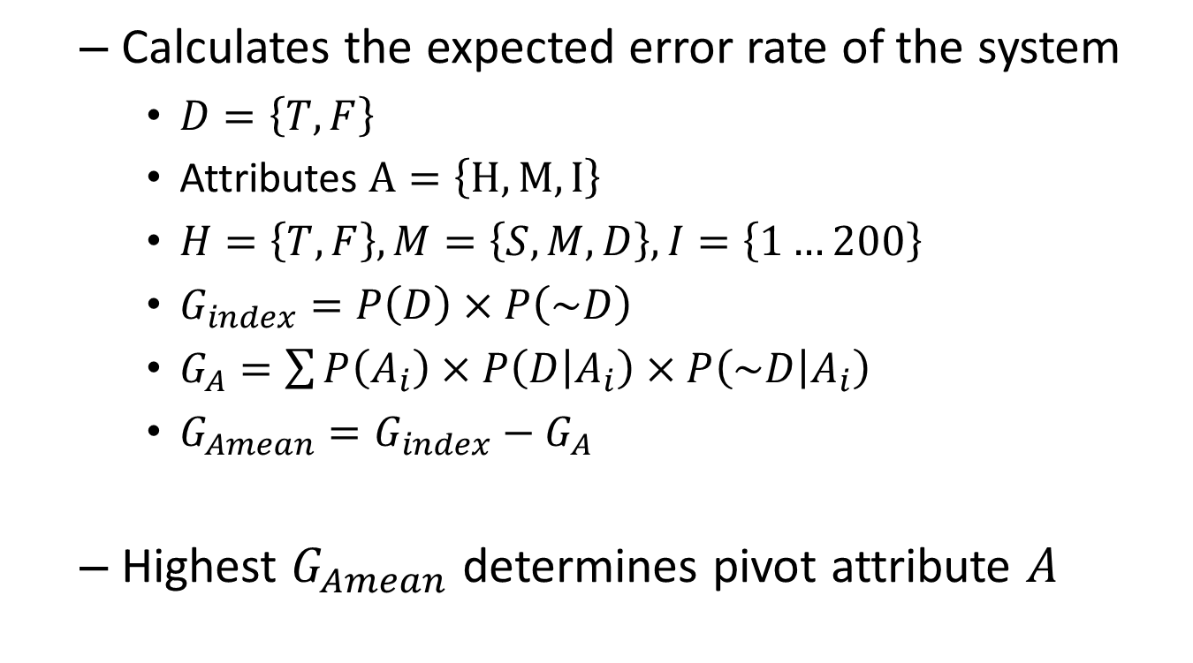
GINI Index
Calculates the expected error rate of the system
$D=\left\{T, F\right\}$
Attributes $A=\left\{H, M, I\right\}$
$H=\left\{T, F\right\}, M=\left\{S, M, D\right\}, I=\left\{1…200\right\}$
$G_{index}=P\left(D\right)×P\left(\sim D\right)$
$G_{A}=\sum{P\left(A_{i}\right)×P\left(D | A_{i}\right)×P\left(\sim D | A_{i}\right)}$
$G_{Amean}=G_{index}−G_{A}$
Highest $G_{Amean}$ determines pivot attribute $A$

Slide 6
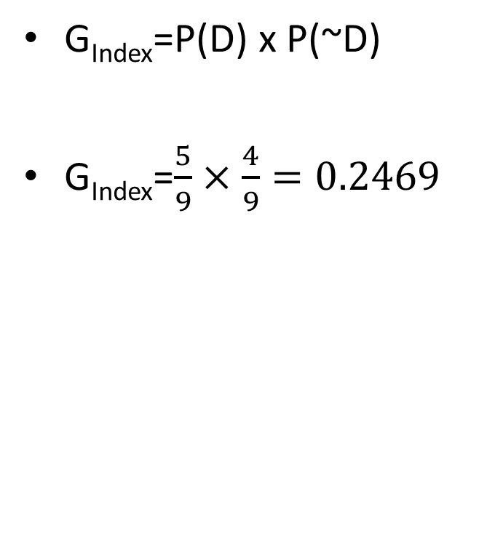
GINI Index
Training Data
D | H | M | I
T | T | M | 2
T | F | S | 10
F | T | S | 22
F | F | D | 31
T | T | S | 5
F | F | D | 14
F | F | M | 50
T | F | D | 37
T | F | D | 11

Slide 7
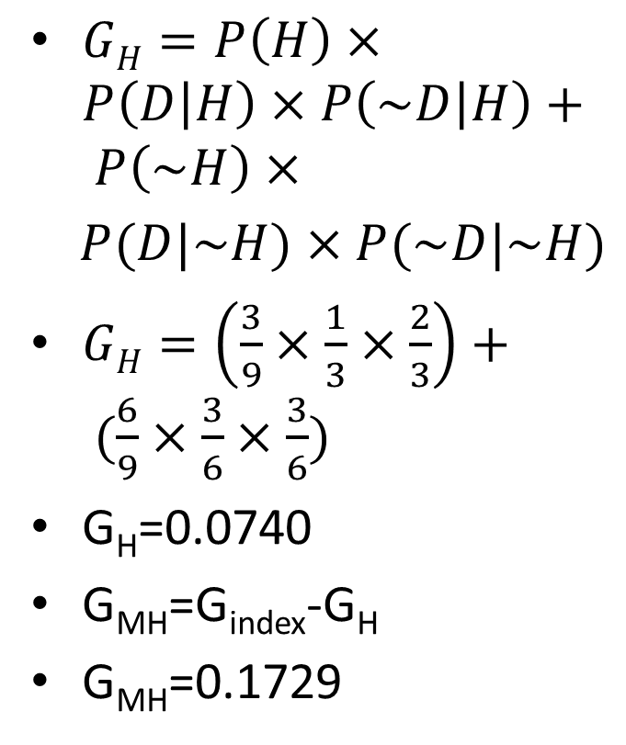
GINI Index
$GH=P\left(H\right)×P\left(D | H\right)×P\left(\sim D | H\right)+ P\left(\sim H\right)×$
$P(D|\sim H)×P(\sim D|\sim H)$
$GH=\left(\frac{3}{9}×\frac{1}{3}×\frac{2}{3}\right)+ (\frac{6}{9}×\frac{3}{6}×\frac{3}{6})$
G_{H}=0.0740
G_{MH}=G_{index}-G_{H}
G_{MH}=0.1729
Training Data
D | H | M | I
T | T | M | 2
T | F | S | 10
F | T | S | 22
F | F | D | 31
T | T | S | 5
F | F | D | 14
F | F | M | 50
T | F | D | 37
T | F | D | 11

Slide 8
ID3
Creates branches until 1 of 3 conditions are met
All members attributes are used, but classifications are still mixed
All members of a branch have the same classification
The branch does not correspond to any of the training cases (is empty)

Slide 9
ID3 Tree Generation
Calculate GINI index and checks for terminal conditions
Training Data
D | H | M | I
T | T | M | 2
T | F | S | 10
F | T | S | 22
F | F | D | 31
T | T | S | 5
F | F | D | 14
F | F | M | 50
T | F | D | 37
T | F | D | 11

Slide 10
ID3 Tree Generation
Calculate mean for each attribute
Selects highest mean as best pivot attribute
Training Data
D | H | M | I
T | T | M | 2
T | F | S | 10
F | T | S | 22
F | F | D | 31
T | T | S | 5
F | F | D | 14
F | F | M | 50
T | F | D | 37
T | F | D | 11

Slide 11
ID3 Tree Generation
Marks pivot attribute as used, separates cases and calls each branch recursively
Training Data
D | H | M | I
T | T | M | 2
T | F | S | 10
F | T | S | 22
F | F | D | 31
T | T | S | 5
F | F | D | 14
F | F | M | 50
T | F | D | 37
T | F | D | 11

Slide 12
ID3 Tree Generation
Marks pivot attribute as used, separates cases and calls each branch recursively
Training Data
D | H | M | I
T | T | M | 2
F | T | S | 22
T | T | S | 5
T | F | S | 10
F | F | D | 31
F | F | D | 14
F | F | M | 50
T | F | D | 37
T | F | D | 11

Slide 13
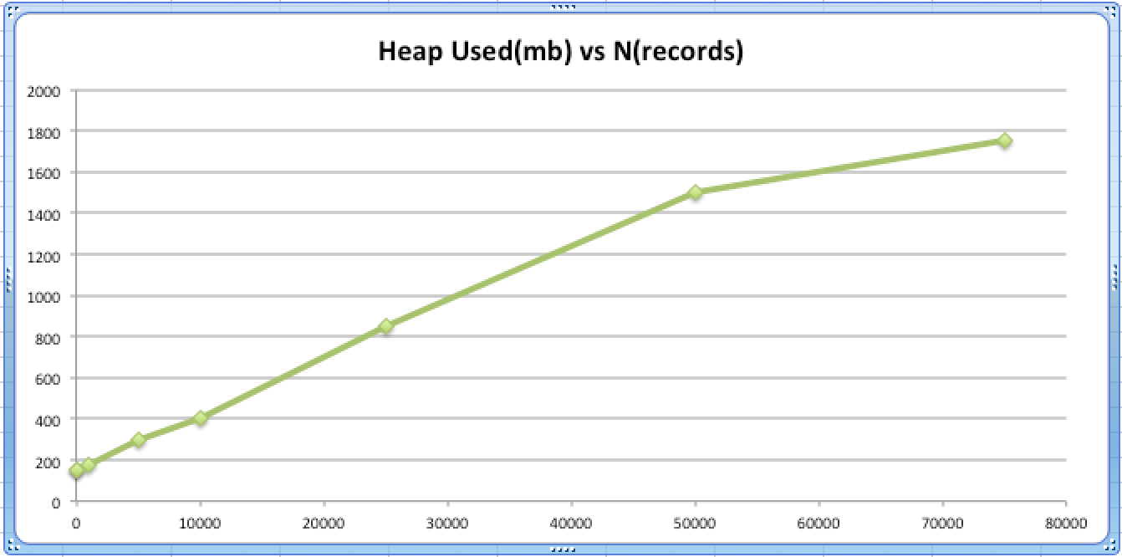
ID3 Tree Generation
Learning complexity
Determined by possible variables of each attribute
A_{i} = Possible results for attribute i
O(n(A_{i} x A_{i-1} x … x A₀)) == O(n)

Slide 14
ID3 Tree Usage
Test data is processed by tree to determine probability of defaulting (P(D)) at relevant leaf
Test Data
D | H | M | I
 | T | S | 105
 | F | M | 100
 | F | D | 40
 | T | D | 50
 | F | M | 70
 | F | D | 20
 | F | S | 60
 | T | S | 115
 | F | D | 20

Slide 15
ID3 Tree Usage
Test case complexity
Complexity for processing each (m) test elements
Processing is linear based on tree height (h).
O(hm) = O(m)

Slide 16
ID3
Algorithm Evaluation
Programmed in Java
Evaluated using Your Kit

Slide 17
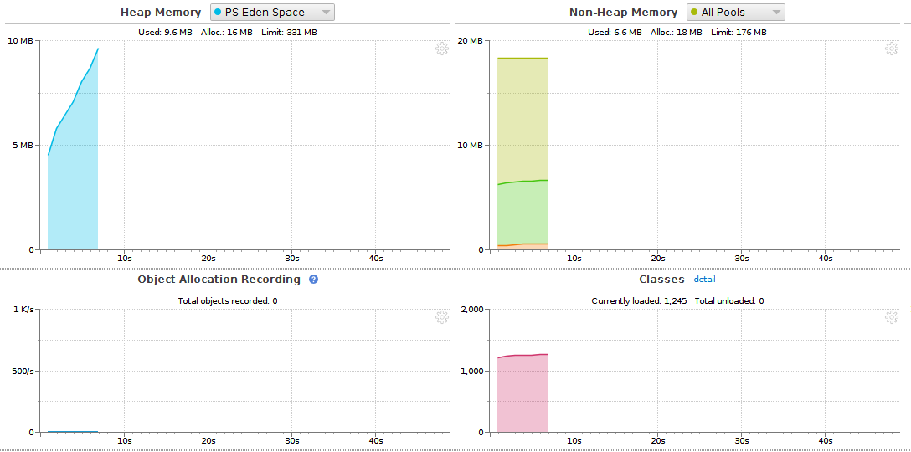
ID3
Test cases at 10m

Slide 18
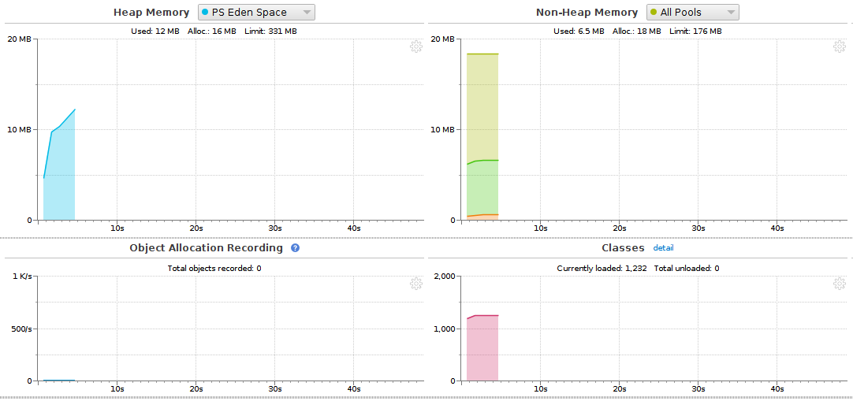
ID3
Test cases at 100m

Slide 19
Questions?

Slide 20
Back-Up
Entropy vs Info gain
Tree Creation – Visualization
Annual Income Split methods

Slide 21
Additional Information
Differences for calculation using entropy
Information gain used highest gain value
Entropy calculation used lowest value

Slide 22
Additional Information
ID3 Tree Building
Pivot attribute determined for root

Slide 23
Additional Information
ID3 Tree Building
Pivot attribute for node marked
Pivot attribute marked used
Data split according to pivot

Slide 24
Additional Information
ID3 Tree Building
Pivot attribute determined for each branch

Slide 25
Additional Information
ID3 Tree Building
Pivot attribute for nodes marked
Pivot attribute at each sub-tree marked used
Data split according to pivot

Slide 26
Additional Information
ID3 Tree Building
Continue recursion for unused attribute values until stop conditions met

Slide 27
Additional Information
Annual Income Split
Training Set Income range
$1k to $200k
Split in $10k increments
Lowest index for a range decides the split in income.
if (income[j] != 0){
clasMean[j]=(double)(income[j]/count)*(defaulted[j]/income[j]*
((income[j]-defaulted[j])/income[j]));
}
if ((clasMean[j] < minGin) && (clasMean[j] != 0)){
minGin = clasMean[j];
minClas = j;
}

Slide 28
Additional Information
Annual Income Split
GINI Mean based on the determined split is then computed for attribute determination.
for (int i = 0; i < 20; i++) {
if (i <= split){
curMeana += (double)(income[i] / count)*(defaulted[i] /
income[i])*((income[i] - defaulted[i]) / income[i]);
} else {
curMeanb += (double)(income[i] / count)*(defaulted[i] /
income[i])*((income[i] - defaulted[i]) / income[i]);
}
}
return gIn - (curMeana + curMeanb);

Slide 29
Additional Information
Node
Leaf : boolean
Attrib : char = {‘H’, ‘M’, ‘I’}
branchA : Node
branchB : Node
branchC : Node / Null
parent : Node
iPivot : int
decision : boolean
children : ArrayList<dataEntry>

Slide 30
Additional Information
dataEntry
mUsed : boolean
hUsed : boolean
iUsed : boolean
maritalStatus : String = {“S..e”, “M..d”, “D..d”}
homeowner : boolean
income : int = {1 to 200}
Defaulted : boolean

Slide 31
References
[1] Hunt, Earl B., Janet Marin and Philip J. Stone. Experiments in Induction. New York: Academic Press, 1966. Book.
[2] Kumar, Vipin, Michael Steinbach and Pang-Ning Tan. Introduction to Data Mining. Boston: Pearson Addison Wesley, 2006.
[3] Powell, Laurel. "Decision Trees and the GINI Index." 2016. You Tube. video. 7 Nov. 2016.
[4] Quinlan, J. R. C4.5 : programs for machine learning. San Mateo: Morgan Kaufmann Publishers, 1993. Book.
[5] Quinlan, J. R. "Induction of Decision Trees." Scopus (1986): 81-106. Journal.

